Slide 1




DIBBs Brown Dog Tutorial Setup

Slide 2
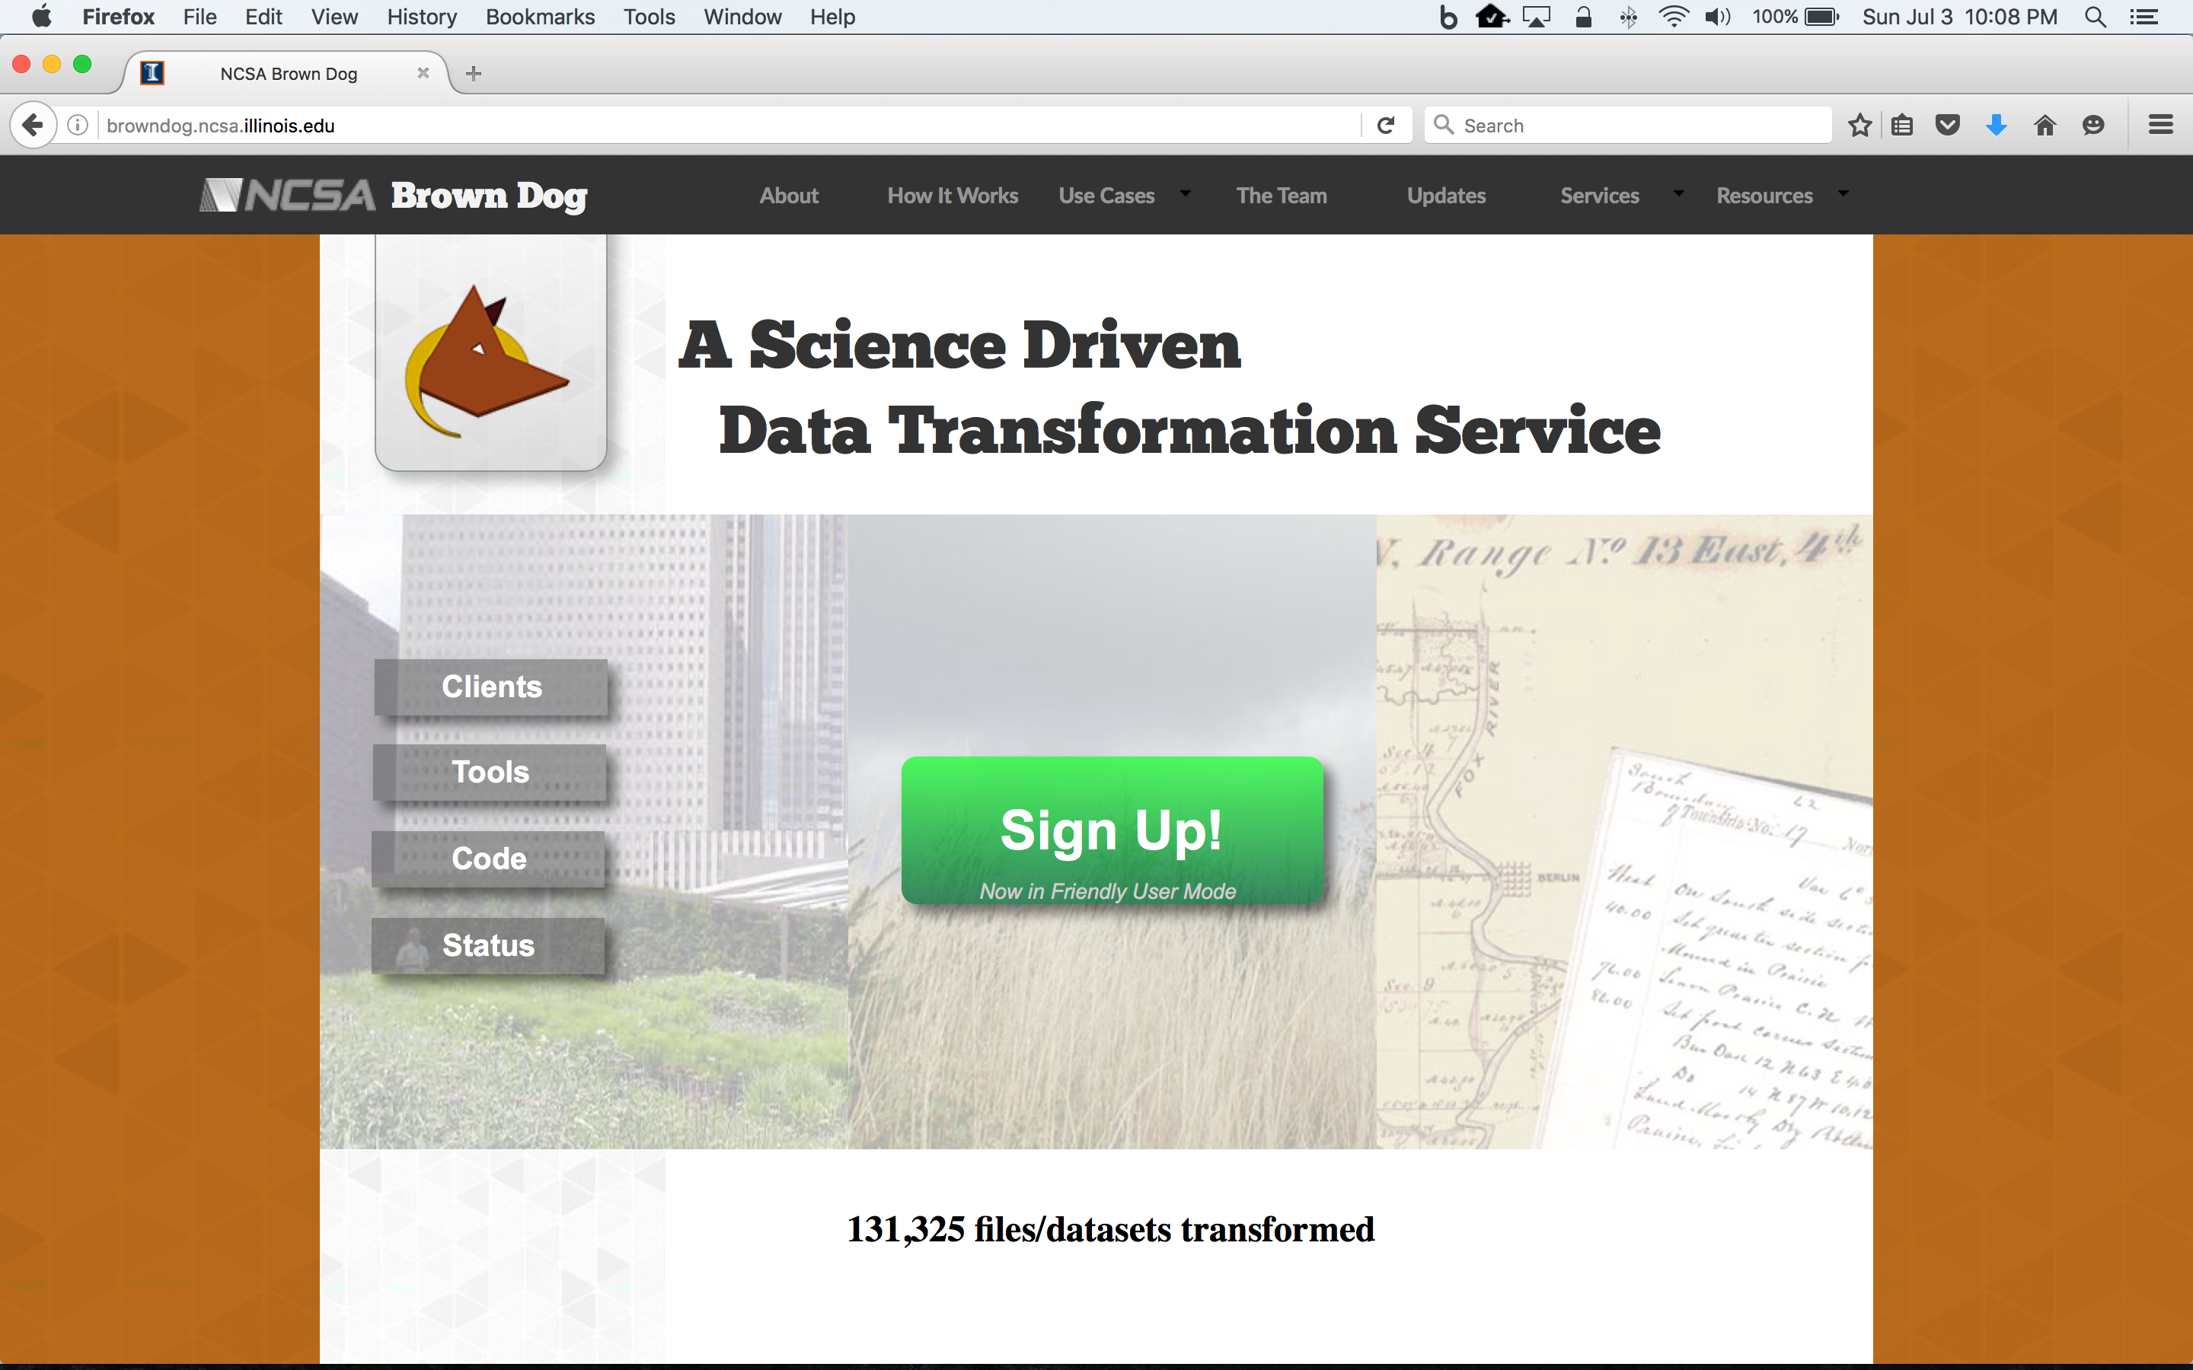
Brown Dog Sign Up
To access Brown Dog services, you need to sign up
Go to http://browndog.ncsa.illinois.edu/ and click Sign Up

Slide 3
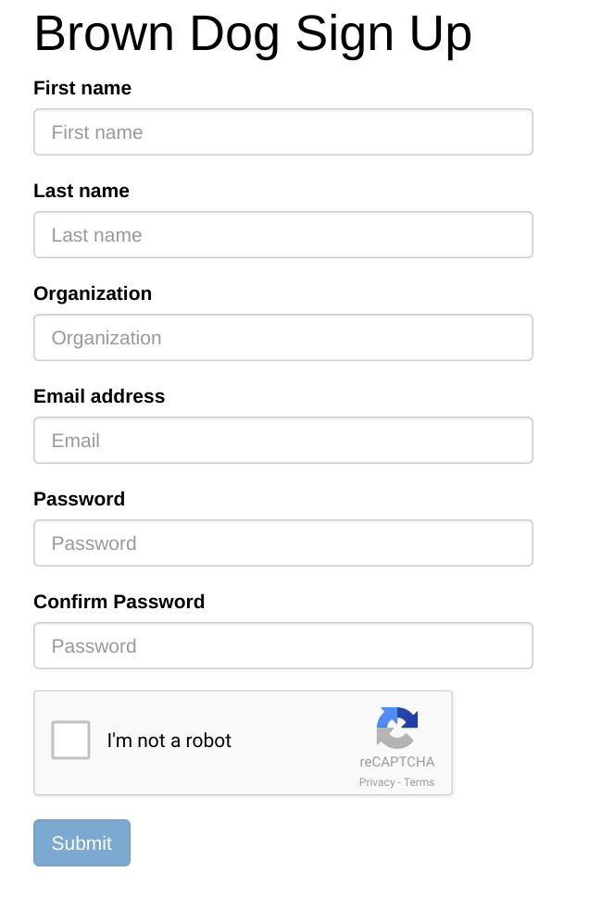
Brown Dog Sign Up
Fill out form
Click Submit

Slide 4
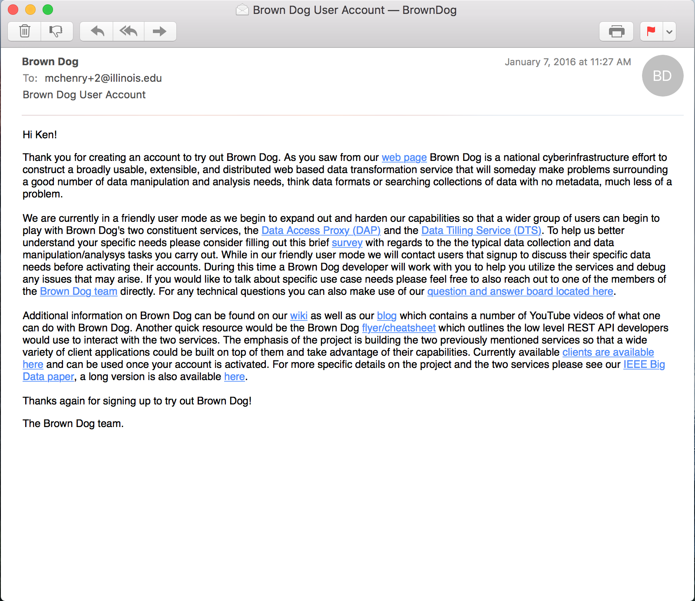
Brown Dog Sign Up
Fill out form
Click Submit

Slide 5
How to Connect to NCSA Nebula VM
You need to use SSH to use Nebula VM for this tutorial
You need to use SFTP/SCP to transfer files b/w Nebula VM and your machine.
Software required:
Linux and MacOS: ssh, sftp/scp
Windows: any ssh client
for example: SmarTTY (ssh/scp client : http://smartty.sysprogs.com/download/)

Slide 6
Accessing Your Nebula VM (Linux/Mac OS X)
Download private key file "XSEDE16-Tutorial" from
http://tinyurl.com/xsede-tutorial
into .ssh directory in your home directory (e.g. /home/<yourusername>/ or /Users/<yourusername>)
Change the mode of the ‘XSEDE16-Tutorial’ to read-only
chmod 600 ~/.ssh/XSEDE16-Tutorial
Find out the Nebula VM’s IP that is assigned to you
Access to the VM
ssh -i ~/.ssh/XSEDE16-Tutorial ubuntu@<your_vm_ip>
And you are done!

Slide 7
Accessing Your Nebula VM (Windows)
Download the private key file "XSEDE16-Tutorial" from
http://tinyurl.com/xsede-tutorial
PortableSmartty on the USB stick
Click on SmarTTY.exe

Slide 8
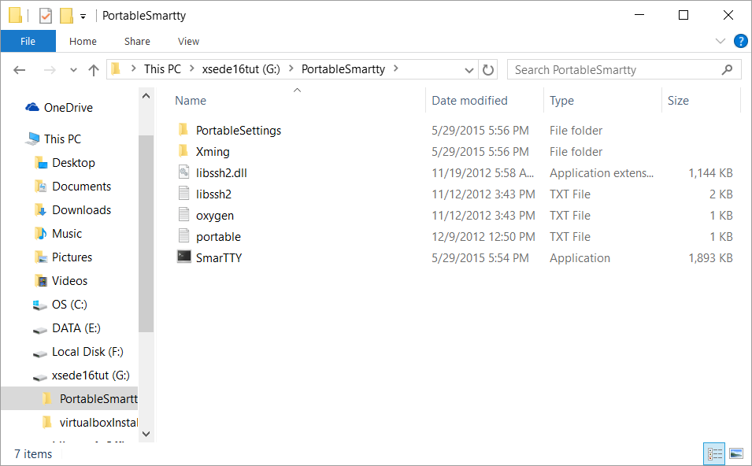

Slide 9
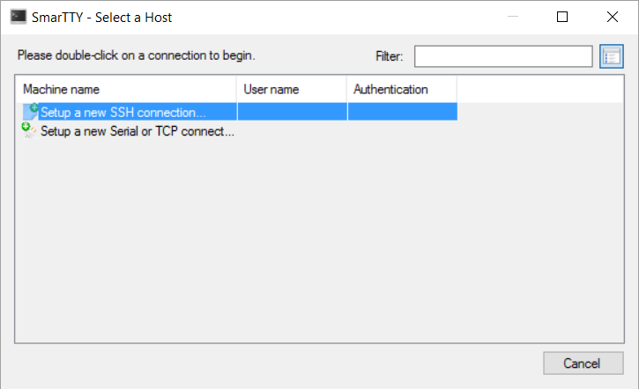
Setup a new SSH connection to Nebula VM

Slide 10
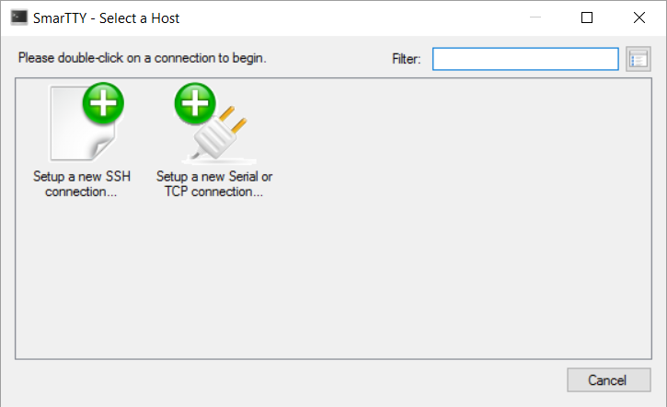
SSH Set up To Connect Nebula VM

Slide 11
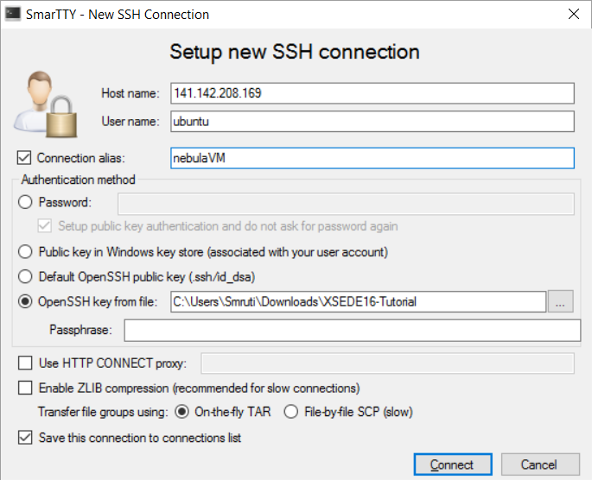
SSH Set up To Connect Nebula VM
NebulaVM IP
ubuntu
Name your session
Upload your private key file
Click

Slide 12
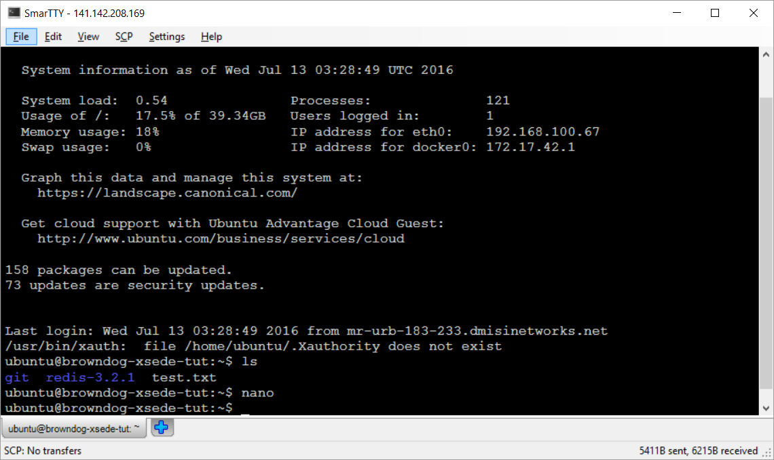
SmarTTY Terminal

Slide 13
Text Editors
Nano - Easy to use text editor (similar to notepad)
type nano <filename> in the command prompt
Commands to save are in the editor terminal itself
Vim
vim <filename>
For more details:
http://www.radford.edu/~mhtay/CPSC120/VIM_Editor_Commands.htm

Slide 14
Linux commands
ls : list all files in the current directory/folder
cd : change directory
cd .. : Go up one directory
pwd : present working directory
~/ : home directory () e.g. /home/ubuntu in the Nebula VM
mkdir dir_name : create/make a new directory
cp <file1> <directory> : copy a file to a directory
cp -R <directory1> <directory2> copy a directory to another directory
cat <filename> display the content of the file
scp (secure copy)
scp -i ~/.ssh/XSEDE16-Tutorial <filename> ubuntu@141.142.x.x:~/git/samplefiles
scp -i ~/.ssh/XSEDE16-Tutorial -r ubuntu@141.142.x.x:~/git/samplefiles ~/path/to/directory

Slide 15
Accessing BD Services locally installed in the VM
To generate tokens in locally installed bdfiddle
username: bdtut.user@xsede.org
password: bdtutXy71816de
While using key_token.py to obtain tokens to access local bdfiddle, you need to type in the following values
Server [bd-api.ncsa.illinois.edu]: localhost:8080
Protocol [https]: http
Username: bdtut.user@xsede.org
Password: bdtutXy71816de

Slide 16
End of Set up

Slide 17
SmarTTY Download
Go to Download page for SmarTTY
http://smartty.sysprogs.com/download/
Downloads a *.msi file
Follow the instructions as provided by the installer

Slide 18
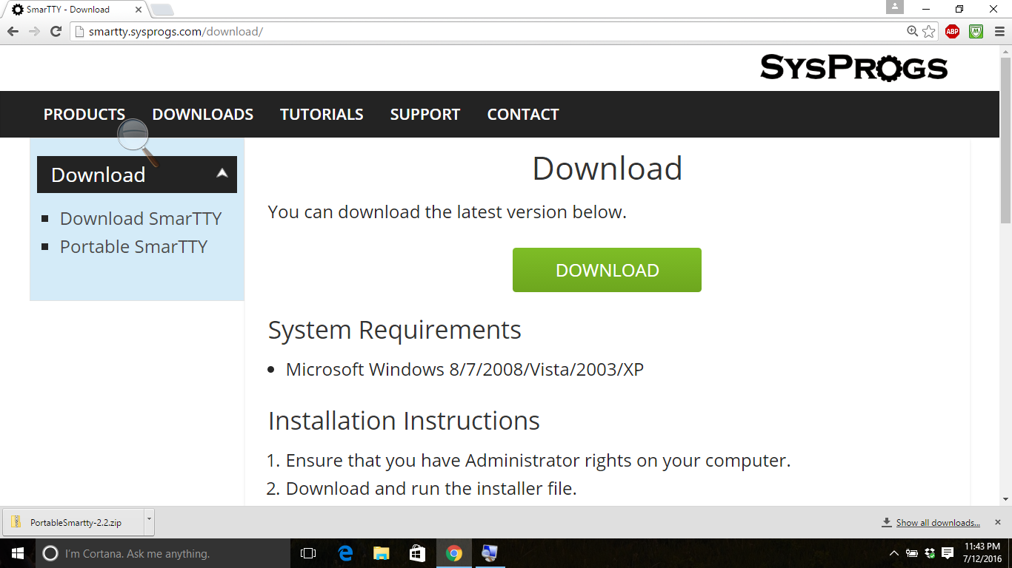
Download SmarTTY http://smartty.sysprogs.com/download/

Slide 19
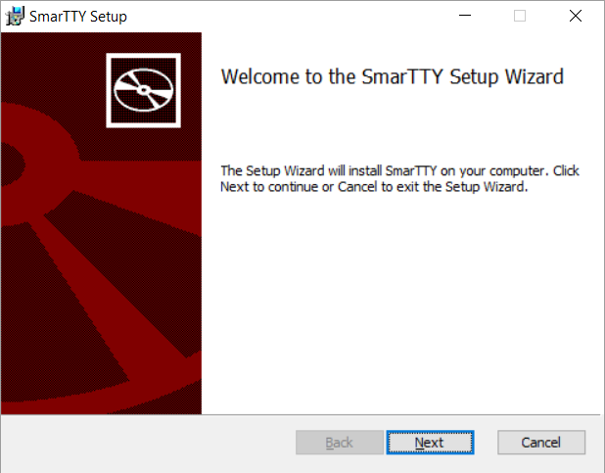
Step 1

Slide 20
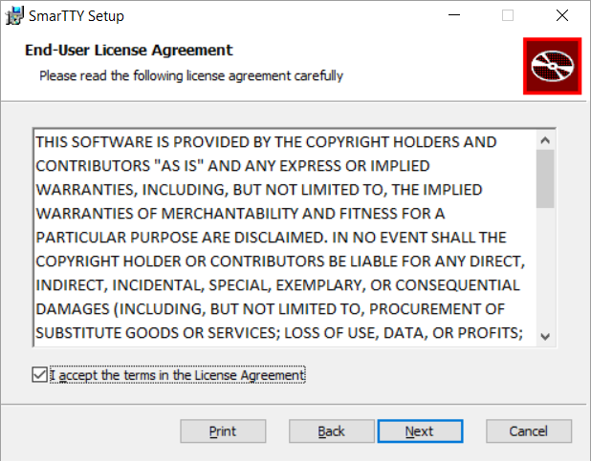
Step 2

Slide 21
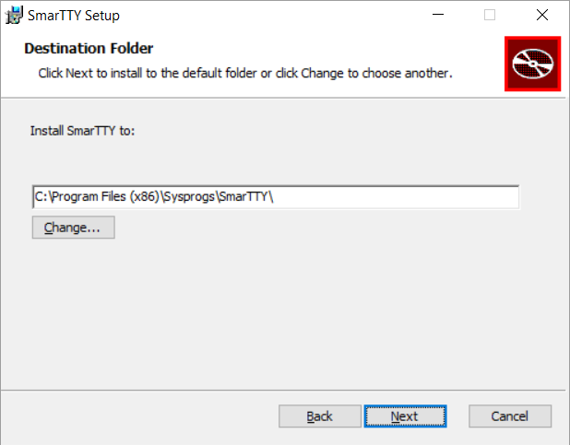
Step 3

Slide 22
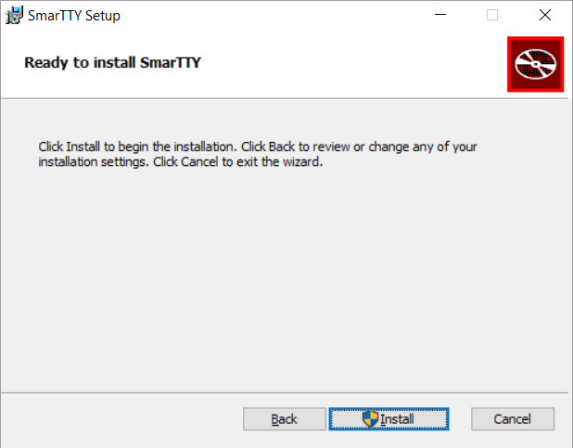
Step 4

Slide 23
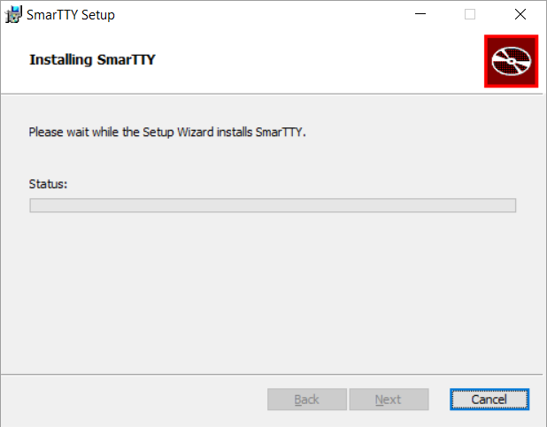
Step 5

Slide 24
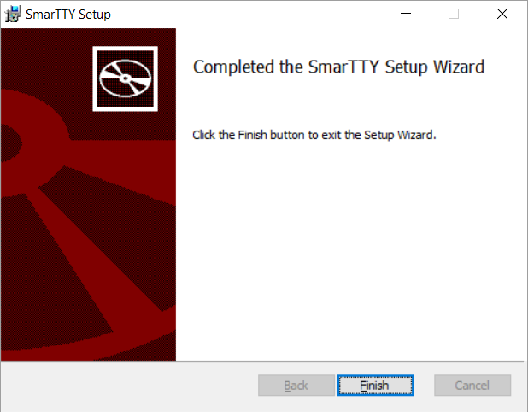
Step 6

